Slide 1
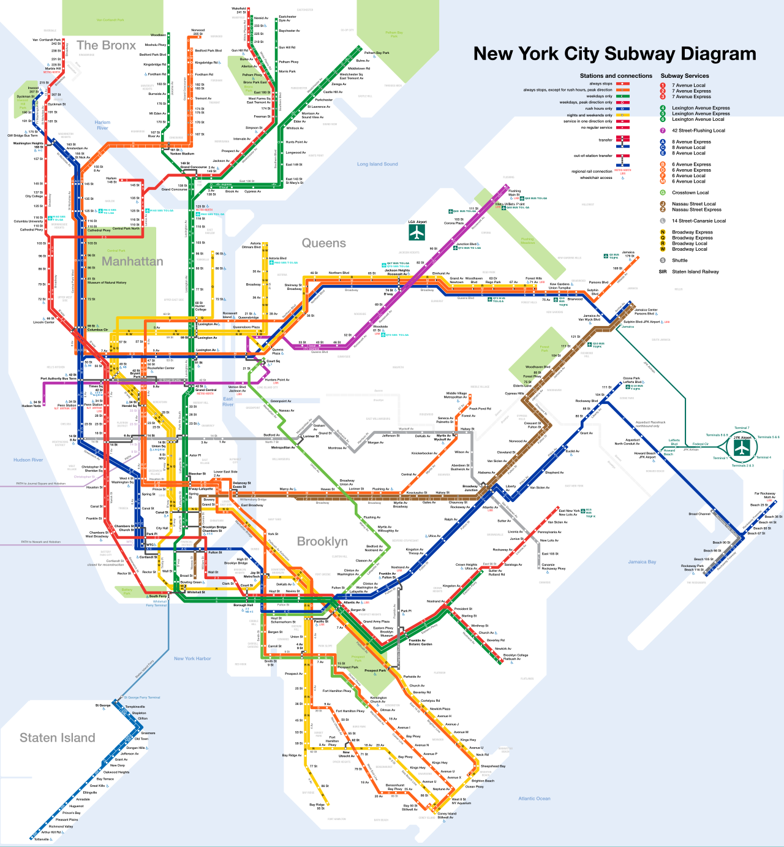
MTA Presentation
Lewis Byrd, Soren Little, Griffin Roth, Caffery Wu

Slide 2
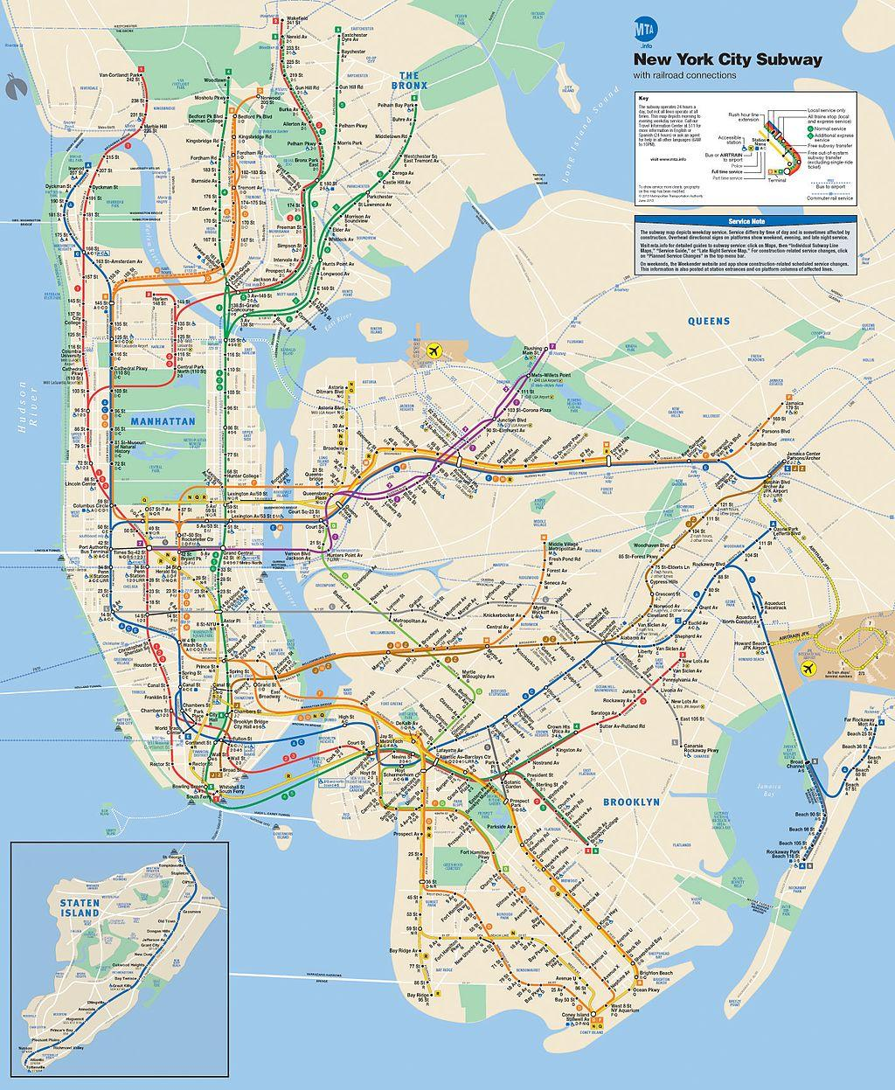
Workflow
Minimize the influence of tourists by calculating if the station is more busy in weekend
Remove all hourly data except for rush hours (4-8 PM, figuring that people wouldn’t want to be stopped when rushing to work)
Figure out the busiest stations at a given rush hour
Prioritize stations near tech firms/industries

Slide 3
Finding Tech Heavy Stations
Find the locations of the biggest tech firms/industries
Find the nearest station to each location
Log each station name, then find out if the station exists in the dataframe and if it has the same name
Prioritize these stations over the rest

Slide 4
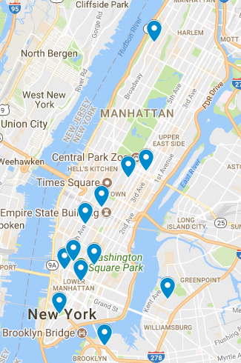
Station
Map

Slide 5
Removing Tourist Stops
Do not want street teams talking to tourists
Weekdays vs. Weekends
More weekend riders means a tourist stop

Slide 6
Busiest Station
Calculate entries to each stations
Calculate the difference in entries at each time frame during the rush hours
Calculate each station entries during rush hour
Make a list of the stations from the most to least entries

Slide 7
Final Recommendations
59 ST
ASTOR PL
5 AV/53 ST
BEDFORD AV
YORK ST
23 ST
PARK PLACE
34 ST-HERALD SQ
HOUSTON ST
PRINCE ST
W 4 ST-WASH SQ
116 ST-COLUMBIA

